Slide 1
Memory Management
Creative Commons Attribution-NonCommercial-ShareAlike 3.0 Unported License. http://creativecommons.org/licenses/by-nc-sa/3.0/
Written by Rachel J. Morris, last updated 2016-02-15

Slide 2

Break all the things!

Slide 3
Types of Memory Errors
Once we're actually working with a system's memory, there are quite a few chances to create problems, such as...
Invalid Memory Address
Memory Leaks
Missing Allocation
Uninitialized Memory Access
And More...

Slide 4
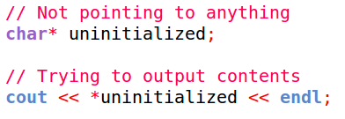
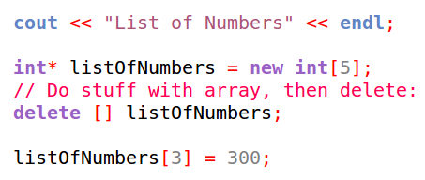
Types of Memory Errors
Invalid Memory Access
Usually occurs when accessing unallocated (or freed up) memory.
This might happen when...
De-referencing a pointer to an invalid address
Pointer without an address
Trying to dereference, no (or garbage) address!
Trying to assign data at an unallocated address
New dynamic array
Deleting dynamic array
Setting value in deleted array

Slide 5
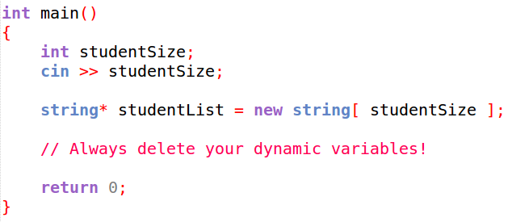
Types of Memory Errors
Memory Leak
Occurs when memory is allocated (via new), but never deallocated (via delete).
Always free any memory that you allocate!
delete [] studentList
is never called, so that memory is never freed!

Slide 6
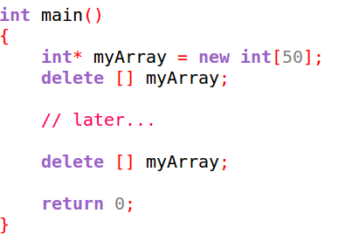
Types of Memory Errors
Missing Allocation
Occurs when you try to free memory that has already been freed!
We don't “own” this chunk of memory after we've freed it, so any data this pointer is pointing to might be corrupted or deleted, affecting other programs running on the system!

Slide 7
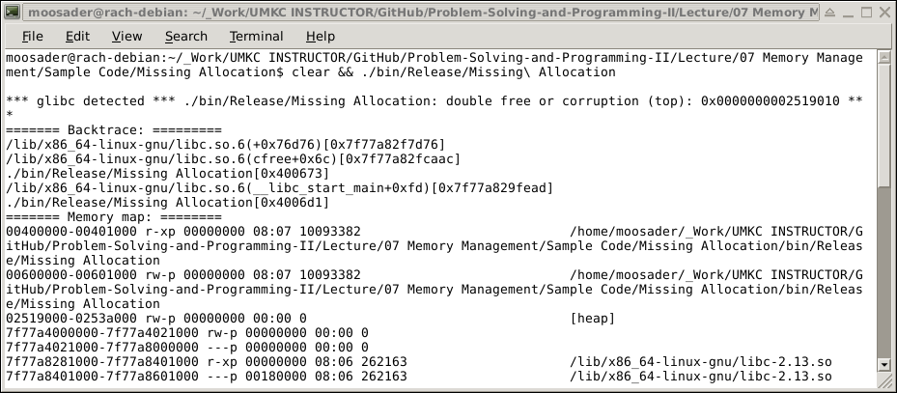
Types of Memory Errors
Missing Allocation
Occurs when you try to free memory that has already been freed!
You'll get a big error message!

Slide 8
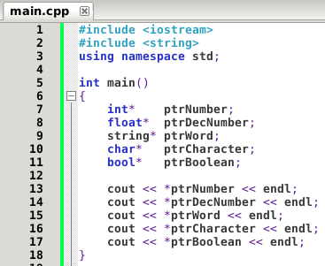
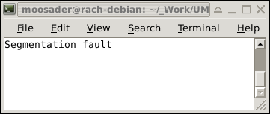
Types of Memory Errors
Uninitialized Memory Access
Occurs when you try try to read a value of an uninitialized variable.

Slide 9

The Stack and the Heap

Slide 10
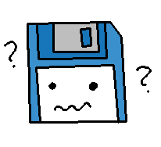
The Stack and the Heap
Different types of variables are stored in different types of memory.
Dynamic arrays are allocated in the heap.
Local variables and parameters are allocated in the stack.
What is a stack
and a heap?

Slide 11
The Stack and the Heap
The Stack
The Stack has a more complex structure than the Heap.
The size of the stack is fixed,
containing a sequence of memory addresses.
There is no need to manually erase memory;
it is “lazy deleted”, and will be overwritten when
that space is needed.
When we declare variables, parameters, or make a function call, this data is pushed onto the Stack.

Slide 12
The Stack and the Heap
The Stack
The stack is optimized,
and the CPU can manage the memory quickly,
dealing with reads and writes.
When a function is called,
its variables are pushed onto the stack.
When the function ends,
its variables are popped off the stack
(in other words, freed).

Slide 13
The Stack and the Heap
The Stack
The stack grows and shrinks as its variables are pushed on and popped off.
We don't manage the memory ourself – It is handled for us automatically.
Variables on the stack only exist while the function that they belong to is running.
Remember that there is also a limit on the size of the stack.

Slide 14
The Stack and the Heap
The Heap...
Handles dynamically allocated memory (dynamic arrays)
Does not automatically deallocated memory; we must do this manually.
Dynamically allocated memory has to be accessed via a pointer.
Large objects, such as arrays, classes, etc., should be allocated here.
There is no size restriction on the heap.
Variables created on the heap are accessible anywhere in the program, by passing pointers around.

Slide 15
The Stack and the Heap
Think of the Stack as dealing with functions
(local variables = variables inside a function)
And think of the Heap as dealing with
dynamic memory and pointers!

Slide 16
The Stack and the Heap
STACK
Optimized and fast
Has a limited size
Automatically handles memory allocation & deallocation
Variables cannot be resized
Relates to local variables & functions.
HEAP
No size limit
Variables can be accessed anywhere
Manual memory management
You can resize your variables

